Slide 1

The EuroSAT dataset
Yu-Chuan Cheng
Fabian Linkerhägner

Slide 2
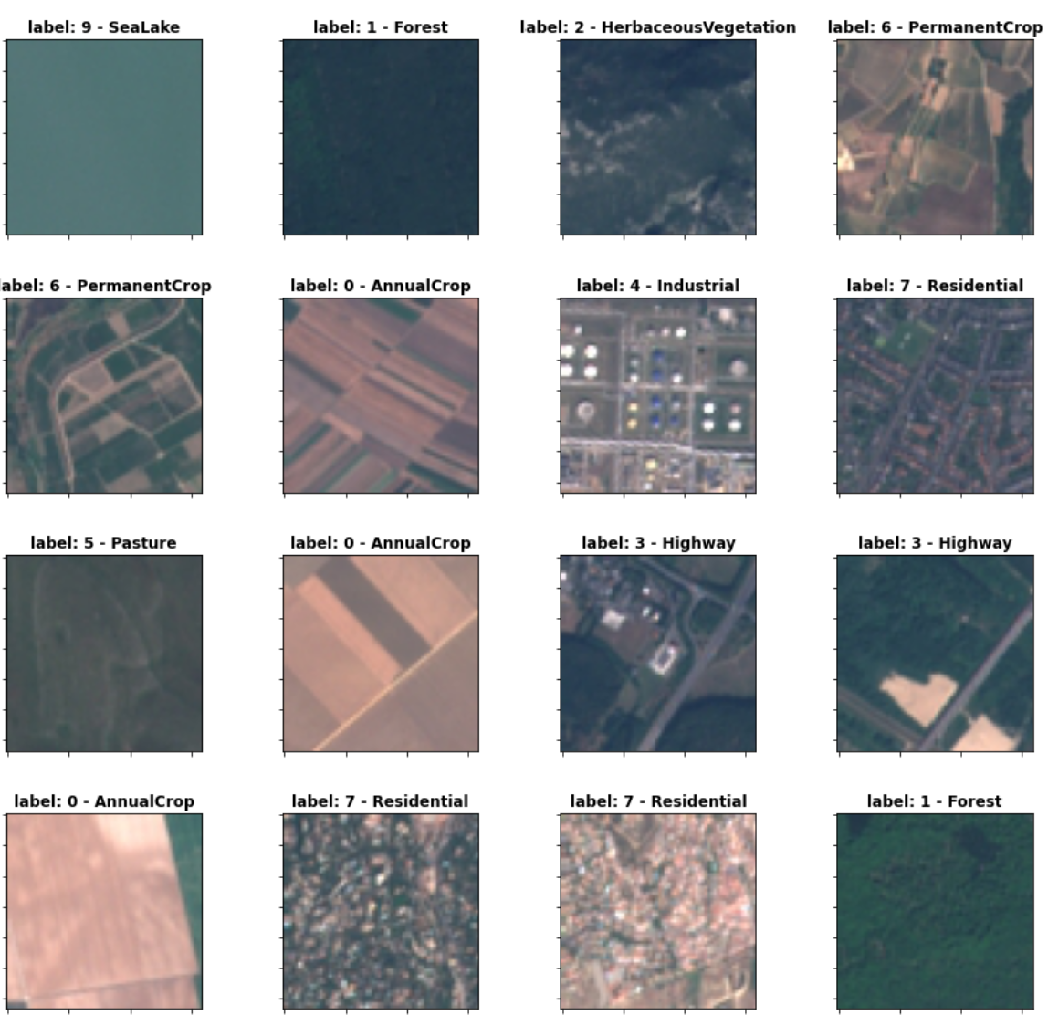
Agenda
Introduction
Recap: Satellite imaging
EuroSAT dataset
Related research
Appilications
EuroSAT data set – batch of 16 random images
source: own work

Slide 3
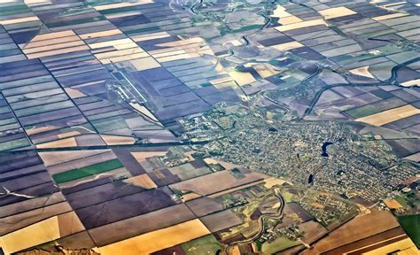
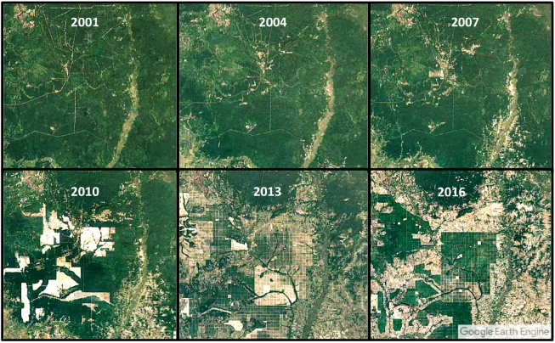
Introduction (1 / 2)
What is land use and land cover classification?
Generate images of earths surface
Define types / classes
Use ML / DL techniques to classify images
What is the difference between land use and land cover?
Land cover: Characteristic of earths surface
Land use: The way humans use it
What are the goals?
Keeping track of signs of climate change
Detect changes in natural landscape
Managing natural ressources (e.g., improving efficiency of land use)
source: rmsi.com
source: pinimg.com

Slide 4
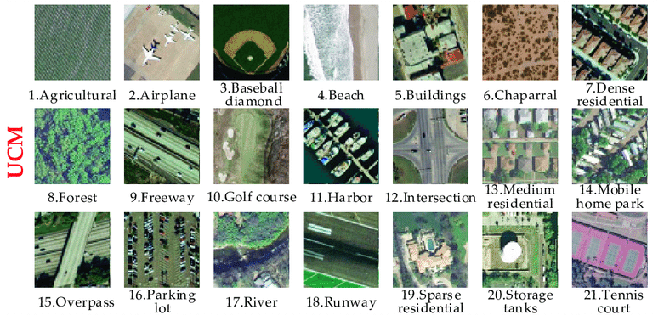
Introduction (2 / 2)
Other datasets for this kind of application
UC Merced (UCM)
PatternNet
NWPU-RESISC45
AID
How do they differ?
They consist of high-resolution images (commercial)
Only „few“ instances for each class
Difficult to compare datasets of different resolution
source: researchgate.net

Slide 5
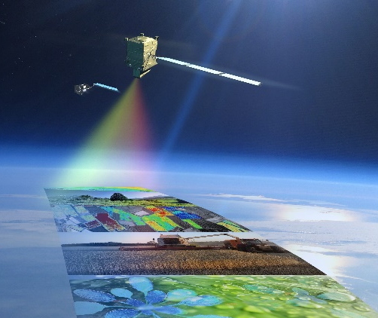
Recap: Satellite imaging
How is it done?
Active and passiv techniques
Active: Sending radar signal and measuring the response
(e.g., TerraSAR-X)
Passive: Detecting light reflected from earths surface
(e.g., Sentinel2)
What is spatial resolution?
defined as the pixel size of an image representing the size of the surface area
What are the characteristics of the satellite used for EuroSAT?
Sun-synchronous
13 spectral bands, spatial resolution up to 10m per pixel
Data is free accessible
source: eijournal.com

Slide 6
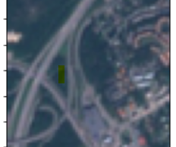
EuroSAT dataset
Basic facts
27.000 images (64x64)
10 classes (2.000 – 3.000 images per class)
34 countries (mostly Germany and France)
all four seasons
spatial resolution of 10m per pixel
RGB and multi-spectral (MS) version
Free accessible at
Data: https://github.com/phelber/EuroSAT
Paper from 2017: https://arxiv.org/abs/1709.00029
Image of „highway“
source: github.com/phelber/EuroSAT
Notes:
Class distribution: pie diagram later in this presentation
Sptaial resolution much lower than other datasets for this application (UCM: 30cm pp)
Reason why RGB and MS version exist is given on the next slide

Slide 7
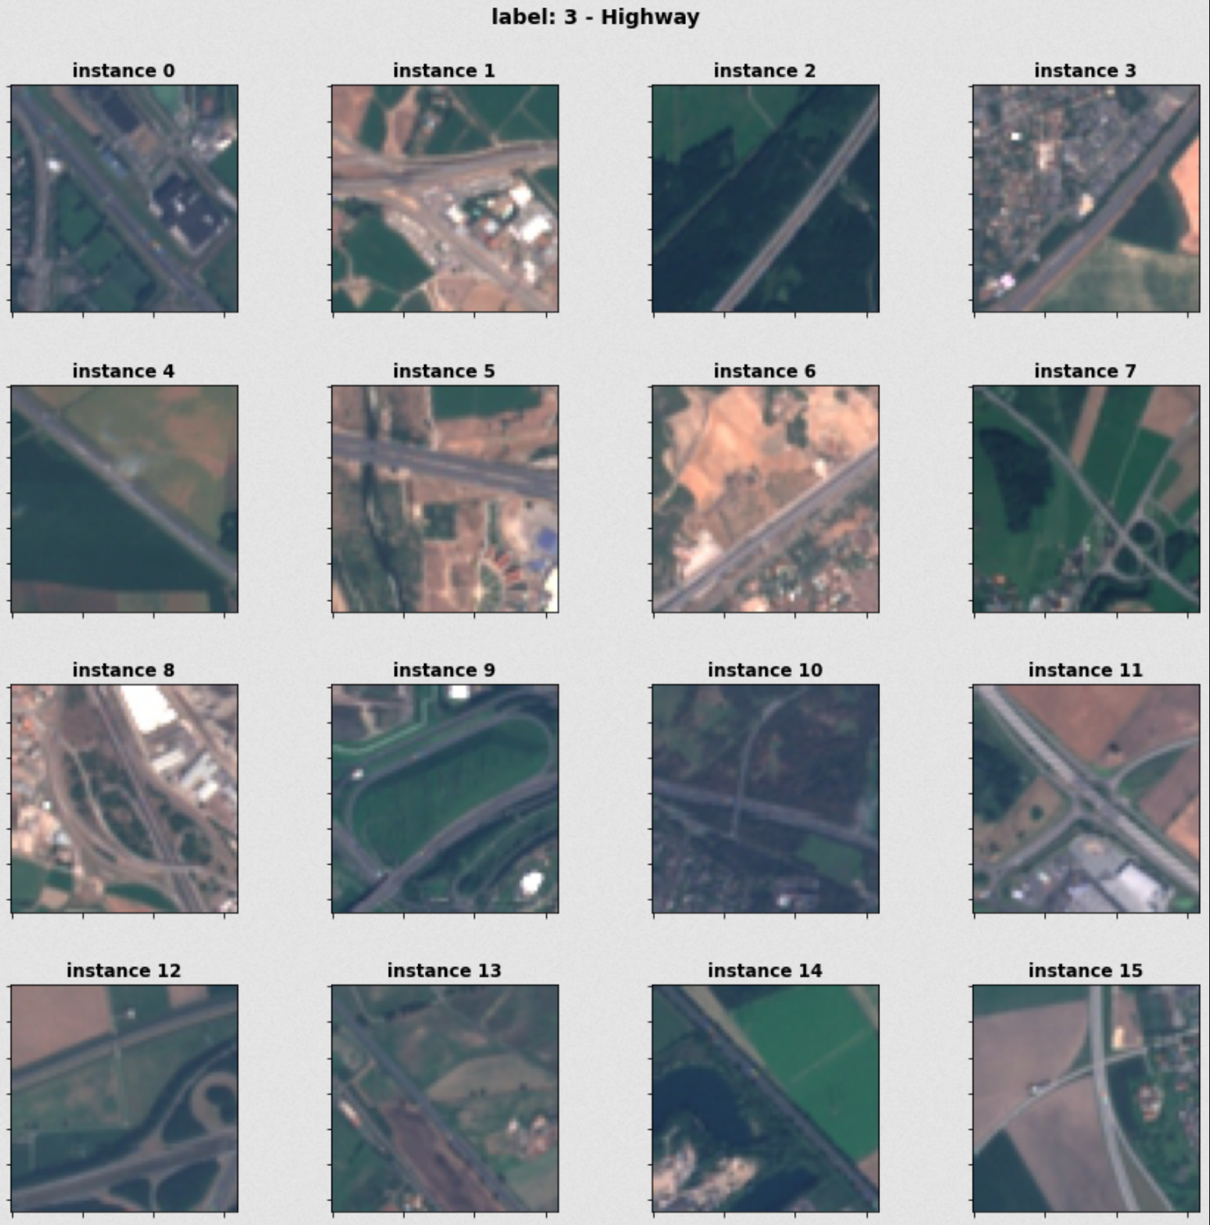

Slide 8
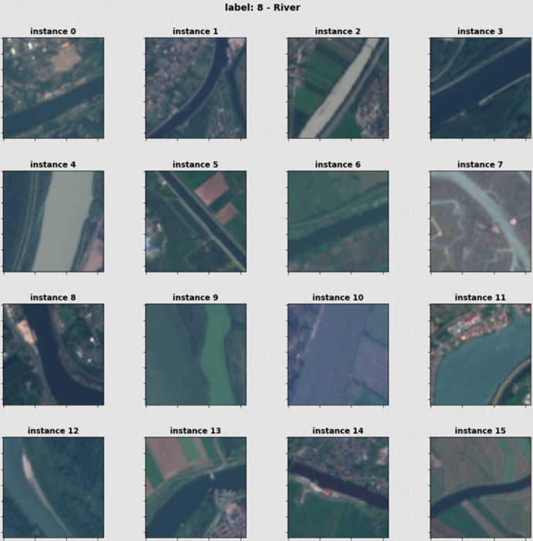

Slide 9
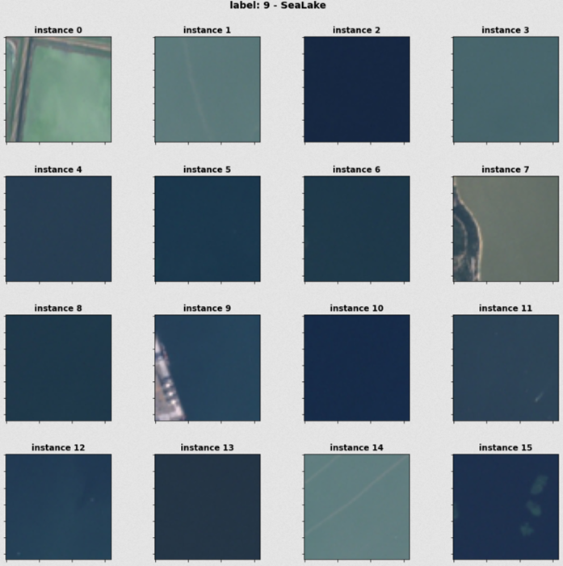

Slide 10
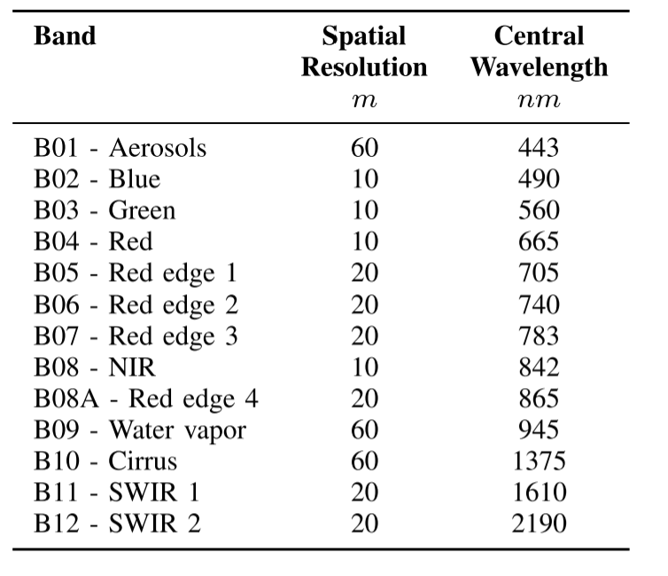
EuroSAT dataset
Why 10 classes?
classes based on European Urban Atlas
spatial resolution: classifier must be able to differentiate
Intra-class variance: seasonal and regional changes (e.g., crops)
Why RGB and MS version?
RGB for comparative evaluation purposes
most of arial and satellite image datasets cover RGB bands
MS: each spectral band can be used for specific task
Spectral bands of EuroSAT dataset
source: https://doi.org/10.48550/arXiv.1709.00029
Notes:
European Urban Atlas: Mapping areas in europe with high population density, Definitions from Urban Audit, cooperation of different statistical insitutions in europe

Slide 11
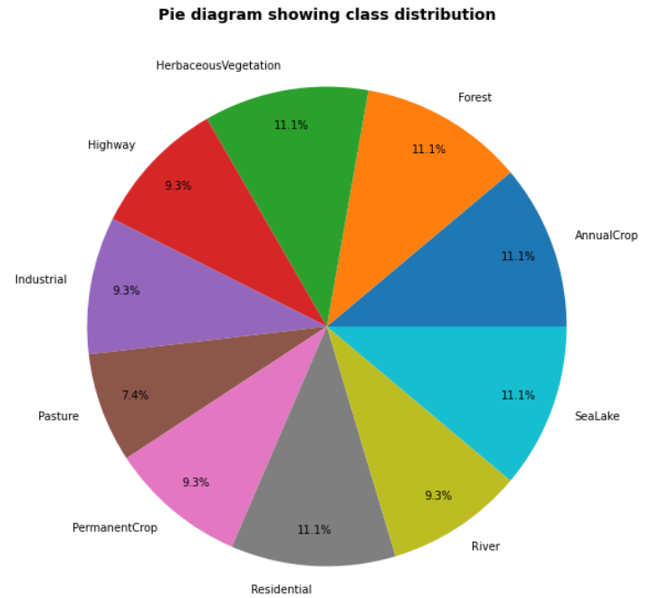
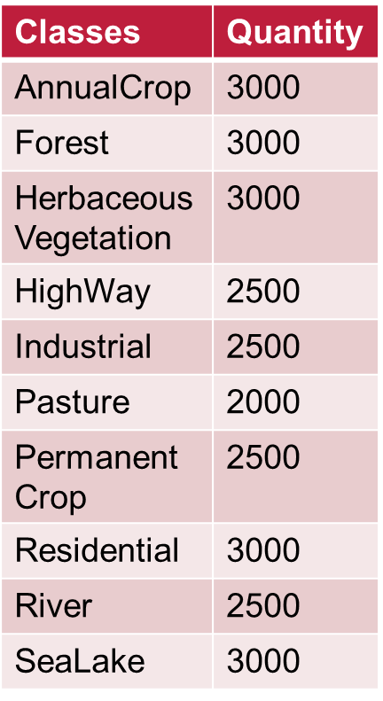
EuroSAT dataset
Notes:
Distribution pretty much even
No specific reason given why the choose this distribution
Maybe training detecting some classes was easier?
10 Classes

Slide 12
Related research
EuroSAT: A Novel Dataset and Deep Learning Benchmark for Land Use and Land Cover Classification
authors: Patrick Helber, Benjamin Bischke, Andreas Dengel, Damian Borth
published in: IEEE Journal of Selected Topics in Applied Earth Observations and Remote Sensing
What was their motivation?
Introducing the first large-scale patch-based dataset (labeled ,georeferenced)
providing benchmarks using state of the art image classifiers (CNN)
evaluation of the performance of each spectral band for the task of classification
What is different from prior reasearch?
More spectral bands (13)
Less spatial resolution (10x lower), but more classes (10 instead of 6)
Free accessible
Notes:
Researches from Technical University of Kaiserslautern, Germany
Older datasets had much higher spatial resolution, aquiring these images is more cost intensive, not non-commercial, you have to pay
Wanting to apply leading technologies of image classification to land use and land cover
Defining performances for spectral bands

Slide 13
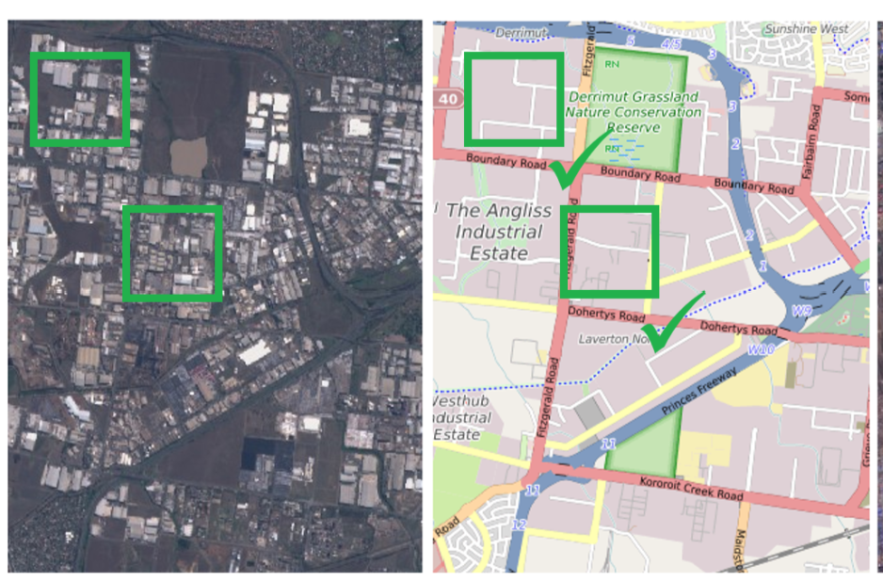
Related research
What were the results?
Benchmarks of different spectral bands (RGB combination best)
maximum of 98.57% accuracy
first step to make use of large amount of free available satellite data
allows for larger scale of earths land surface monitoring
Where can the results be applied?
Land use and land cover change detection
Improvement of geographical maps
Improvement of geographical maps
source: https://doi.org/10.48550/arXiv.1709.00029

Slide 14
Thank you for your attention!
Any questions?

Slide 15
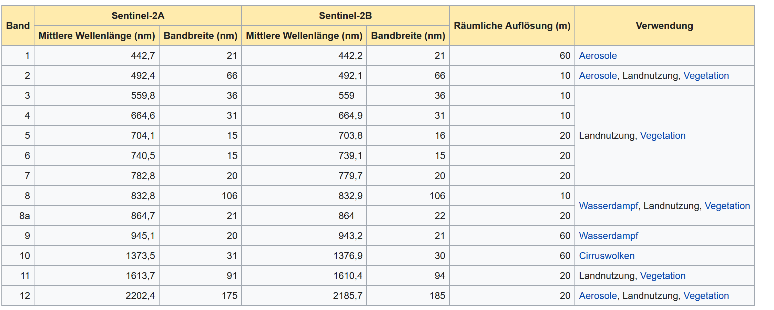
BACKUP

Slide 16
BACKUP
2,79 GB of data (extracted)

